Slide 1
Graphics File Format
A graphics format file reader is responsible for opening a file, determining its validity and interpreting the information contained within it.
A reader may take its input , source image data either from a file or from the data stream of an input device, such as a scanner or frame buffer.

Slide 2
Graphics File Format
There are two types of reader designs:
i. Filter ii. Scanner.
A filter reads a data source one character at a time.
The Scanners randomly access across the entire data source. They can read and reread data anywhere within the file.
Filters require small amount of memory while the Scanners require a larger amount of memory.

Slide 3
Reading Graphics File Data
Image data are read from a Graphics File.
Compressed image data is read one byte at a time from file and into memory before it is decompressed.
Uncompressed image data is often stored only as bytes, even when the pixels are two three or four bytes in size.

Slide 4
Writing a Graphics File Data
Inverse of Reading a graphics file
Writers may send data directly to an output device, such as a printer or they may create image files and store data in them.

Slide 5
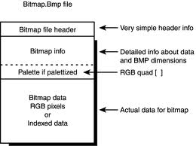
BMP
BMP
A Bitmap File (BMP) contains an exact pixel mapping of an image which can then be reconstructed by rendering application on the display surface of an output device.
BMP file consists of:
Header Bitmap Data Color Palette other Data

Slide 6
BMP
The Header
Consists of binary or ASCII format data located at the beginning of the file., but the information about the bitmap data is stored elsewhere in the file.
A Bitmap Header is composed of
i. File Identifier
A header starts with a unique identification value called a File Identifier, file IP or ID.
ID values are assigned arbitrarily by the creator of the file format, and can be a series of ASCII characters

Slide 7
BMP
ii. File Version
Successive version of bitmap formats differ in header size, bitmap data supported and color capability.
After verifying the file format, an application examine the version value, determine whether it can handle the image data located in the file.
iii. Bitmap Data
In many bit map files Bitmap Data is found immediately after the end of the file header.
Bitmap data is composed of pixel values.

Slide 8
BMP
Sequence of values that logically maps bitmap data in a file to an image on the display surface of an output device
Pixels on an output device are usually drawn in scan lines corresponding to rows spanning the width of the display surface.
Image data is usually first assembled in one or more blocks of memory.
Exactly how the data is arranged then depends on a number of factors, including the amount of memory installed, the amount available to the application, and the specifics of the data acquisition or file write operation in use.

Slide 9
TIFF
Acronym of Tag Image File Format
TIFF specification was intended for storing black and white images, created by scanners
There are three sections in a TIFF file:
- Image File Header (IFH)
- Image File Directory (IFD)
- Bitmap Data

Slide 10
TIFF
Image File Header is always at the beginning of the TIFF file, occupying the first eight bytes in every TIFF file.
IFH contains three fields of information
An identifier, used as byte order identifier and having a size of a word
A version , contains version number of the TIFF format.

Slide 11
TIFF
IFD offset is a 32 bit value. It is offset position of the first image file directory in TIFF file. We use this value to identify the starting position of the image file information
One way to verify whether the file is a TIFF file is by checking the first four bytes of the file
Image File Directory is used to describe the bitmapped data to which it is linked
It contains information of height , width, and depth of image colors and compression types used and doesn’t have a fixed size and position in a TIFF file

Slide 12
VISUALIZATION OF DATA SETS
Scientific Visualization:
Use of graphical methods as an aid in scientific and engineering analysis
  High-volume data sources from supercomputers,
  satellite and spacecraft scanners,
  radio-astronomy telescopes
  medical scanners
Visualization techniques: Analyzing processes occuring over a long time period
To visually display, enhance, and manipulate information to allow better understanding of the data
Computer graphics Image processing Computer vision
Business Visualization
Visualization methods employed by commerce, industry

Slide 13
VISUALIZATION OF DATA SETS
Data Set Classification
Data sets are classification according to
Their spatial distribution
Data type.
Two-dimensional data sets have values distributed over a surface
Three-dimensional data sets have values distributed over the interior of a cube, a sphere
Data types include scalars, vectors, tensors, and multivariate data.

Slide 14
Visual Representations for Scalar
Scalar quantity: Single value.
Scalar data sets contain values that may be distributed in time, or over spatial positions
Some examples of physical scalar quantities:
energy density mass temperature
pressure charge resistance reflectivity frequency
Visualizing Method
Graphs or charts that show the distribution of data values as a function of other parameters, such as position and time.
Interpolate the data values to display a smooth surface.
Pseudo-color methods to distinguish different values in a scalar data set, and color-coding techniques can be combined with graph and chart methods.

Slide 15
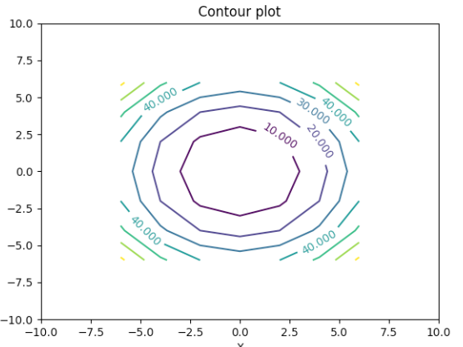

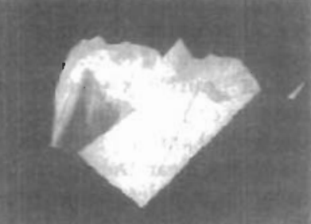

Slide 16
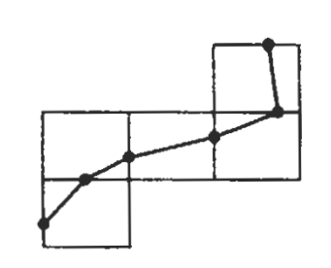
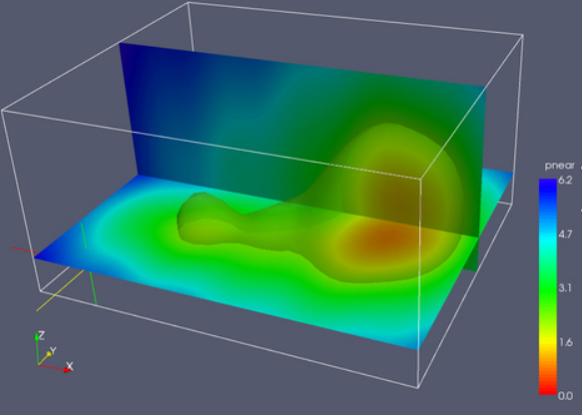
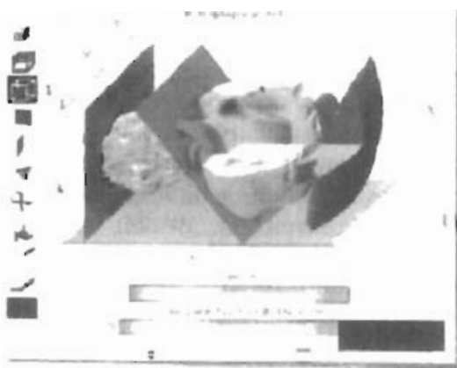
Visual Representations for Scalar
A two-dimensional contouring algorithm traces isolines from cell to cell within grid by checking four corners of grid cells to determine which cell edges are crossed by a particular isoline.
For three-dimensional scalar data fields, cross sectional slices can be taken and display two-dimensional data distributions over the slices.
Color code data values over a slice, or display isolines.

Slide 17
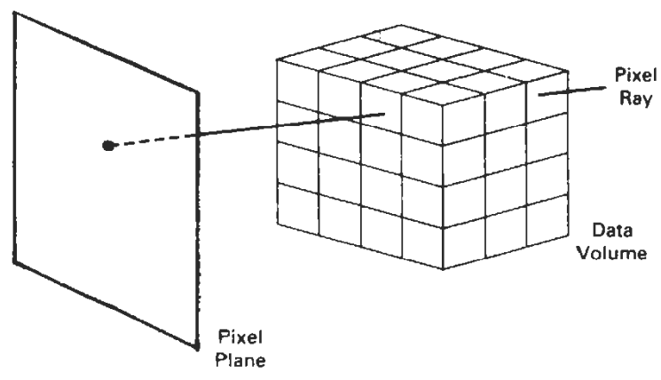
Visual Representations for Scalar
Volume rendering: 3D data set visualization method similar to X-ray picture
Interior information about a data set is projected to display screen using ray-casting methods introduced
Along ray path from each screen pixel, interior data values are examined and encoded for display
Seismic data is often examined to find maximum and minimum values along each ray
In medical applications, data values are opacity factors in the range from 0 to 1 for the tissue and bone layers.

Slide 18
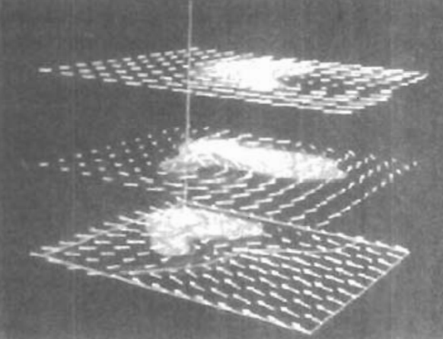
Visual Representations for Vector Fields
Vector quantity V in 3D space has 3 scalar values (V_{x}, V_{y}, V_{z}) one for each coordinate direction, and a two-dimensional vector has 2components (V_{x}, V_{y}).
Another way to describe a vector quantity is by giving its magnitude IVI and its direction as a unit vector u.
Vector quantities may be functions of position, time, and other parameters.
Physical vector quantities: velocity, acceleration, force, electric fields, magnetic fields, gravitational fields, and electric current.
Visualization:
Plot each data point as a small arrow that shows the magnitude
and direction of vector.
Used with cross-sectional slices, since it can be difficult to see
data trends in a 3D region cluttered with overlapping arrows.

Slide 19
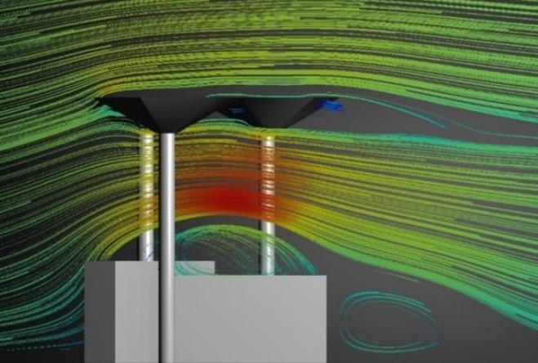
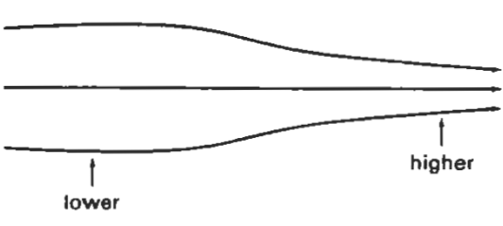
Visual Representations for Vector Fields
Vector values can be represented by plotting field lines or streamlines.
Field lines are commonly used for electric, magnetic, and gravitational fields.
Magnitude of vector values is indicated by spacing between field lines, and direction is the tangent to the field.

Slide 20
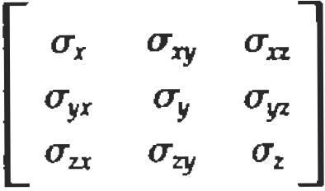
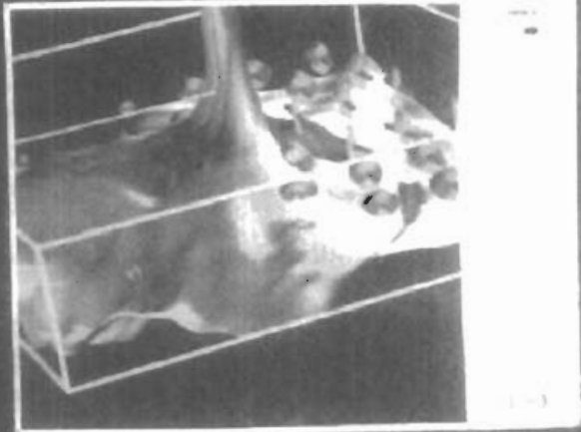
Visual Representations for Tensor Fields
Tensor quantity in 3D space has nine components and can be represented with a 3 by 3 matrix.
Some examples of physical, second-order tensors are stress and strain in a material subjected to external forces, conductivity (or resistivity) of an electrical conductor, and the metric tensor, which gives the properties of a particular coordinate space.
The stress tensor in Cartesian coordinates
The x, xy, and xz elements of the conductivity tensor describe contributions of electric field components in the x, y, and z directions to current in x direction.
Visualization schemes for representing all six
components of a second-order tensor quantity are
based on devising shapes that have six parameters.

Slide 21
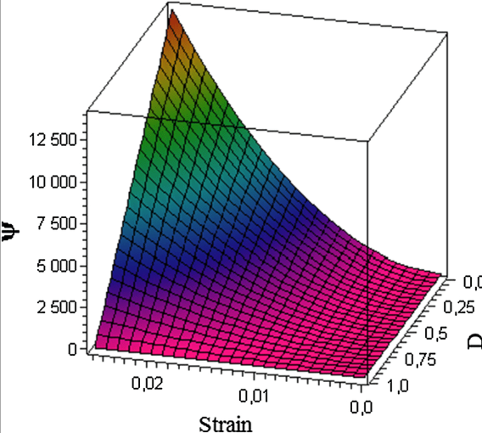
Visual Representations for Multivariate Data Fields
At each grid position over some region of space, there may be multiple data values, which can be a mixture of scalar, vector, and even tensor values.
A method for displaying multivariate data fields is to construct graphical objects, sometimes referred to as glyphs, with multiple parts.
Each part of a glyph represents a physical quantity.
The size and color of each part can be used to display information about scalar magnitudes.
To give directional information for vector field, wedge, cone, or some other pointing shape for glyph part can be used representing vector.

